Slide 1
Open-Channel SSD
BAI Shuhan

Slide 2
1
Motivations

Slide 3
1.1
Development Trends

Slide 4
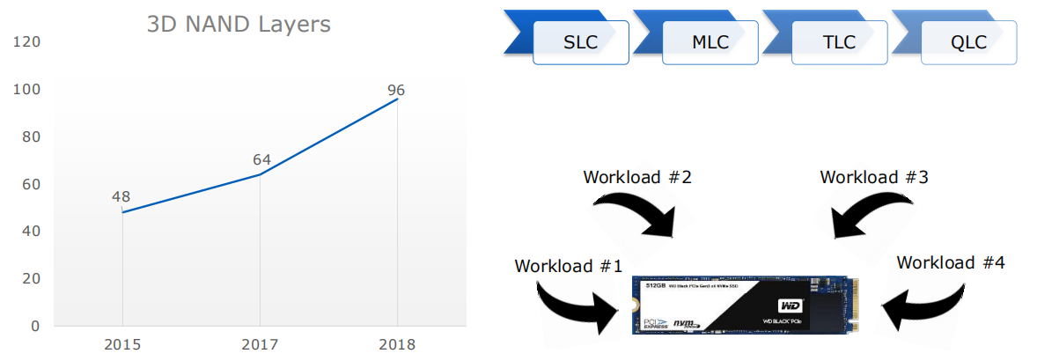
NAND Chip Density Continues to Grow While Cost/GB decreases
more bits inside one cell
more layers
lower R/W speed
shorter SSD lifespan
more need for FTL optimization
multiple workloads
cannot guarantee IO
isolation

Slide 5
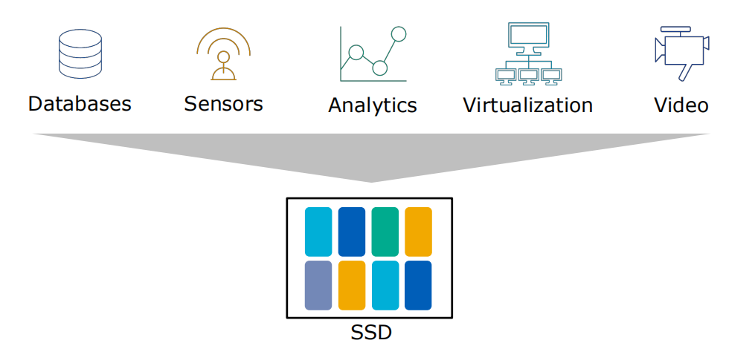
Ubiquitous Workloads Efficiency of the Cloud requires many different workloads of a single SSD
nowaday general SSD's FTL cannot be suitable for different kinds of workloads
Unable to realize SSD's full potential
nowaday general SSD's FTL is decided by firmware, lose flexibility

Slide 6
1.2
Traditional SSD

Slide 7
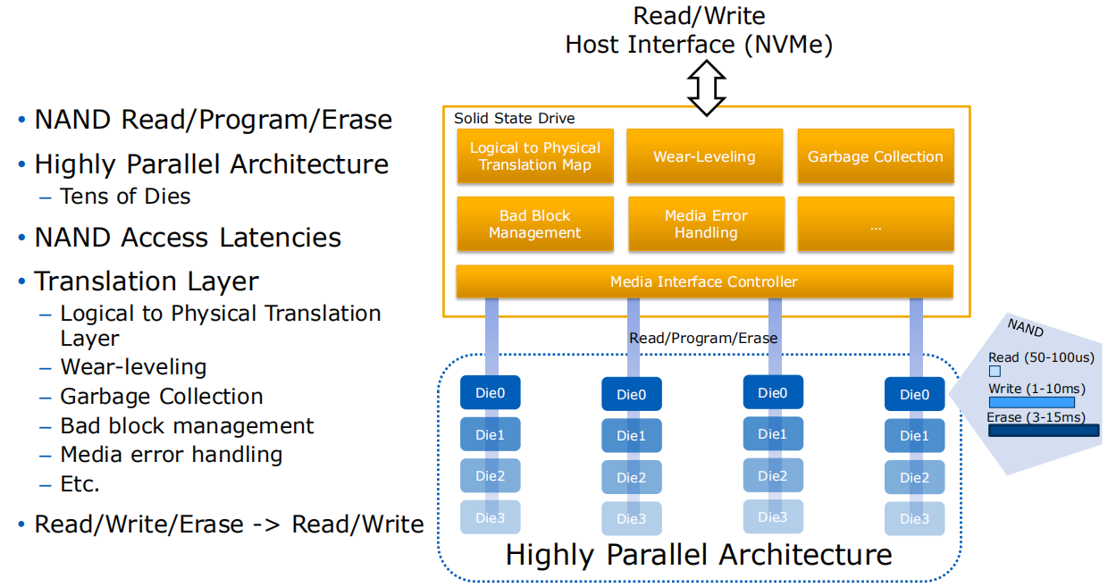
Solid State Drive Internals
FTL inside 'blackbox' causes unpredictable IO latency
(conflict between foreground user IO and background GC IO)

Slide 8
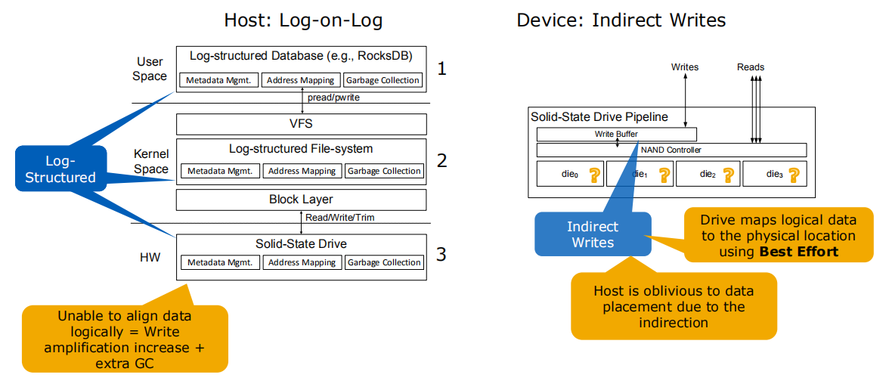
Single-User Workloads Indirection and Indirect Writes causes outliers
further causes the SSD
lifetime degradation
semantic gaps between
host and device
cannot fully use SSD's
internal parallelism

Slide 9
Motivations
General FTL cannot satisfies various kinds of workloads
Isolation between different user IOs cannot be guarantee
Device-side FTL causes unpredictable IO latency
Device-side FTL causes semantic gaps and users cannot fully use SSD's internal parallelism
Functional redundancy → WA → lifetime degradation
Open-Channel SSD

Slide 10
2
OCSSD

Slide 11
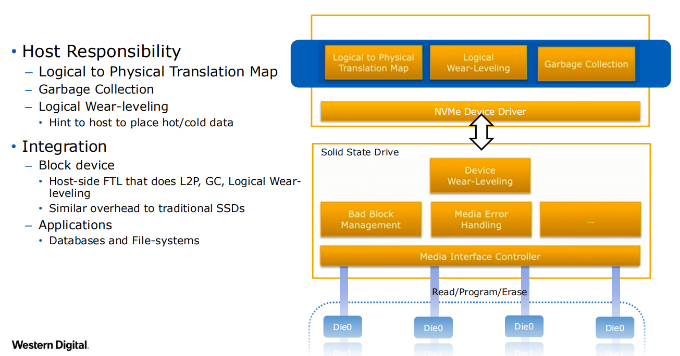
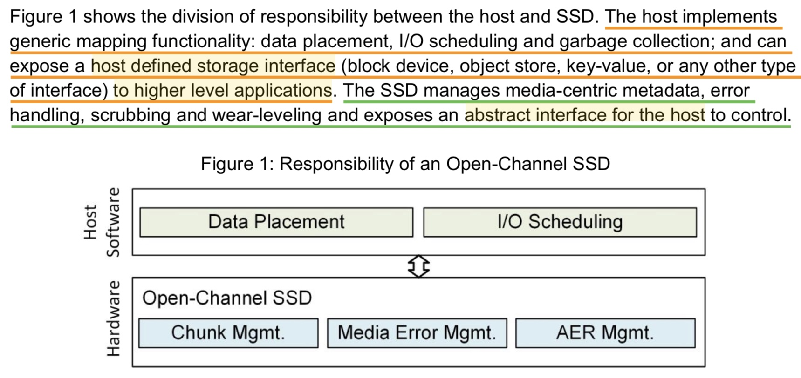
Open-Channel SSD Internals

Slide 12
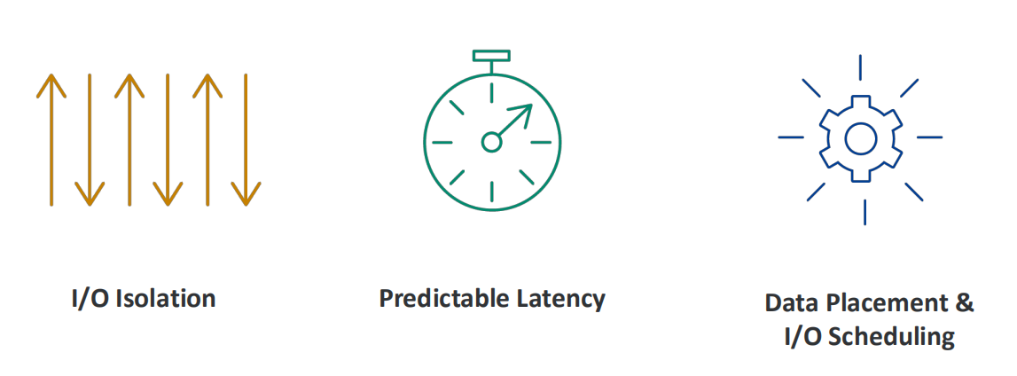
Open-Channel SSD Advantages
application → target → io isolation (PUs are physical isolation, and an Open-Channel SSD exposes a hierarchical representation of its logical blocks, this allows the host to control which parallel unit is accessed independently from other parallel units.)
host controls device management, data placement and IO scheduling → predictable latency
software-defined FTL → higher performance (SSD firmware should not be optimized for any particular workload, as the host will manage access to the parallel units and which chunks are accessed, such that the host can manage the SSD characteristics with respect to parallelism.)

Slide 13
3
LightNVM

Slide 14
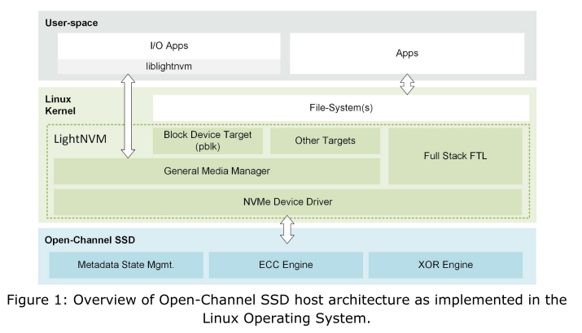
Storage Software Stack
three fundamental components:
LightNVM compatible device drivers, media managers, and targets
Notes:
NVMe Device Driver: 检测OCSSD；实行PPA接口；根据上层传来的LightNVM请求构造NVMe请求（将LightNVM命令格式转换为具体驱动程序的命令格式，即NVMe命令格式）；将底层设备作为传统Linux块设备呈现给用户空间
General Media Manager（LightNVM子系统）：对应到具体的物理设备，隐藏物理介质写约束和实现细节，为每个设备创建一个target实例，其实例在PPA接口支持的块设备的基础上（即NVMe Device Driver之上）初始化；管理target的划分，指定用于管理target的FTL；通过内部nvm_dev数据结构和sysfs等向上层公开设备几何结构信息，公开vector IO，为上层FTL的实现做准备
pblk：LightNVM的一种FTL的一种FTL实现，向用户空间/内核模块提供高级IO接口；将底层设备作为传统块设备呈现给用户空间

Slide 15
3.1
NVMe Device Driver - PPA IO Interface
Implement PPA Command Set
Activate LightNVM - make devices to support LightNVM

Slide 16
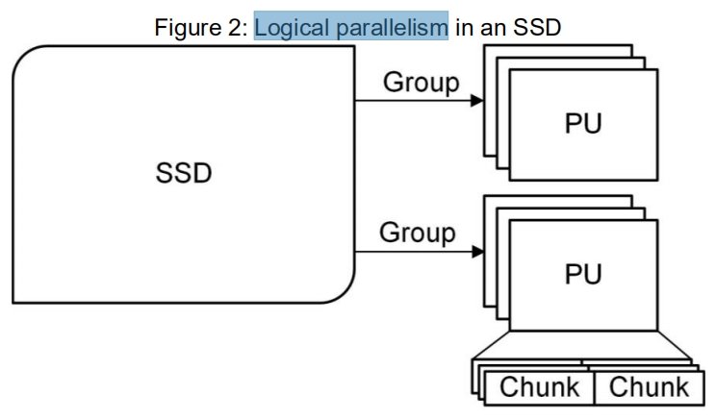
Open-Channel SSD Representation
Group: a set of PUs that share the same transfer bus. (Channel)
Parallel Unit: the unit of parallelism within the SSD, and its access is fully independent of other parallel units. (a (set of) Die(s))
Chunk: a set of contiguous logical blocks. The logical blocks shall be written sequentially within the chunk. A chunk is the smallest range of logical blocks that can be reset as a unit. (a (set of) Block(s)) (minimum erase size)
Logical Block: the smallest addressable data unit for Read and Write commands. This takes on the meaning from the NVMe specification, and does not represent a physical flash block. (LBA) (minimum read size) (a (set of) Page(s))
Write Unit: the smallest number of logical blocks that shall be written at a time. (minimum write size)

Slide 17
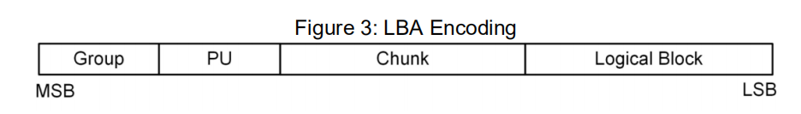
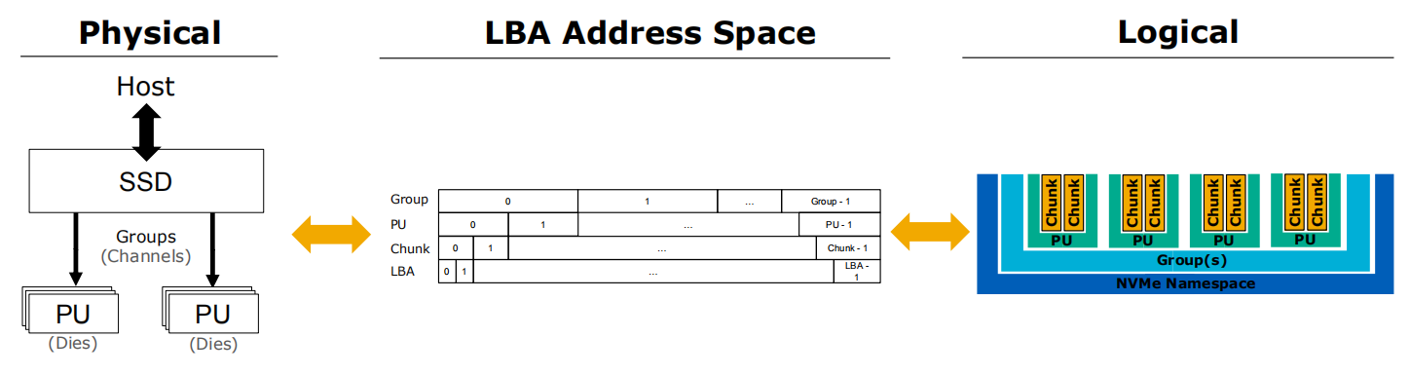
Open-Channel SSD Representation
Just a logical representation!

Slide 18
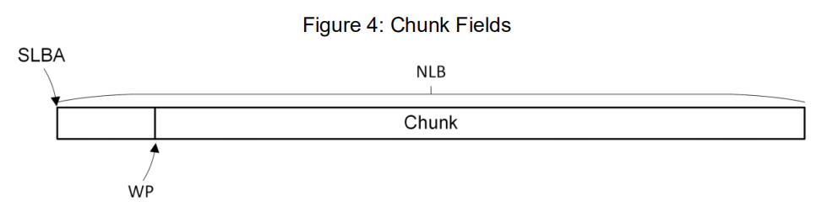
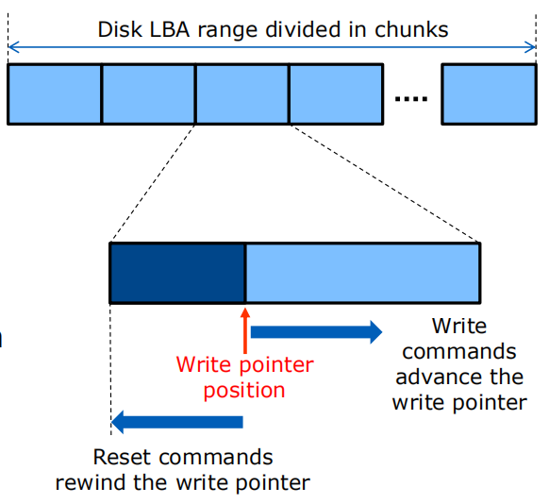
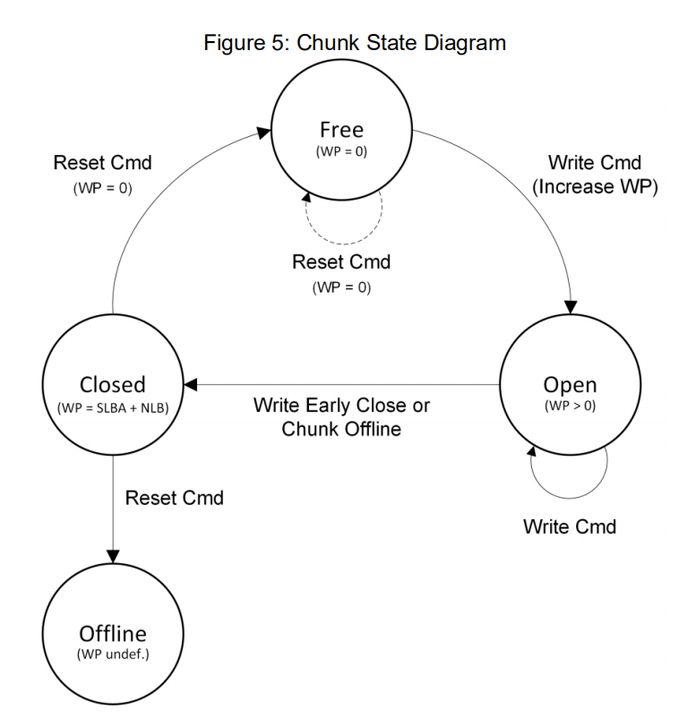
Chunks

Slide 19
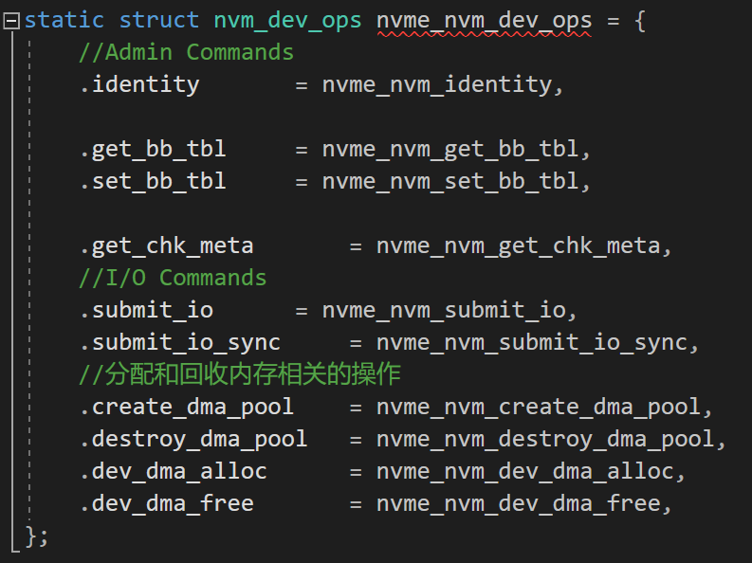
Physical Page Addressing IO Interface
the Physical Page Addressing Command Set has been extended to the NVMe specification
code: drivers/nvme/host/lightnvm.c
Admin Commands & I/O Commands

Slide 20
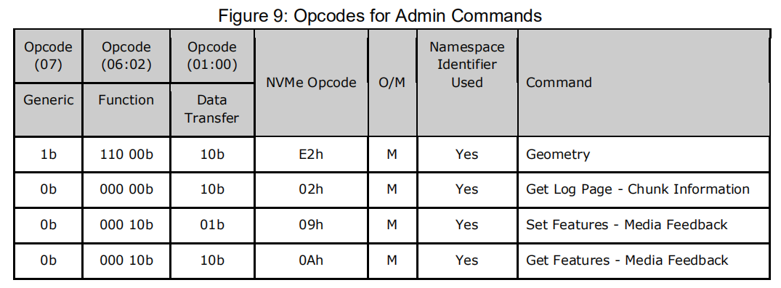
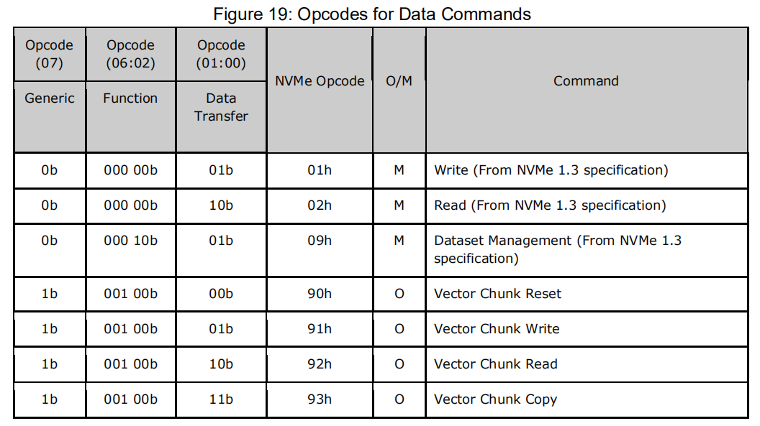
Physical Page Addressing IO Interface

Slide 21
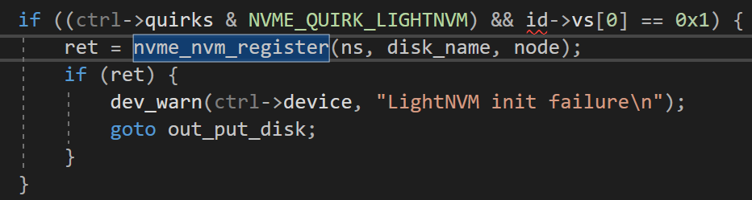
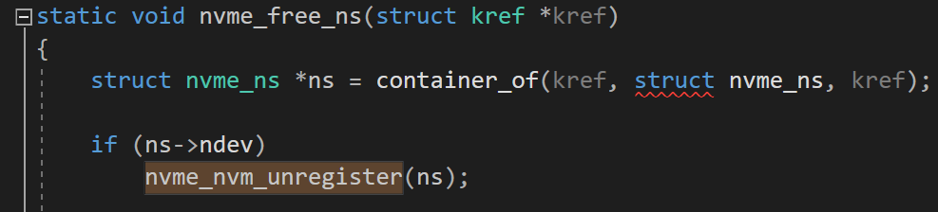
Activate LightNVM - Make Device to Support LightNVM
register LightNVM
code: drivers/nvme/host/core.c
nvme_alloc_ns() - call nvme_nvm_register()
unregister LightNVM
code: drivers/nvme/host/core.c
nvme_free_ns() - call nvme_nvm_unregister()

Slide 22
3.2
General Media Manager
Create target (pblk) for each device which supports LightNVM

Slide 23
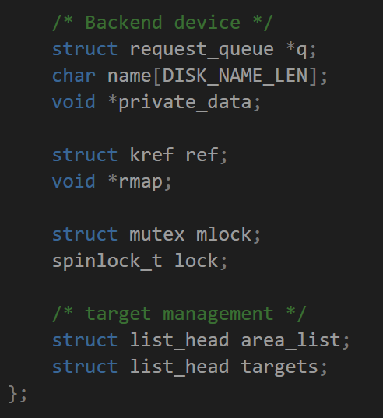
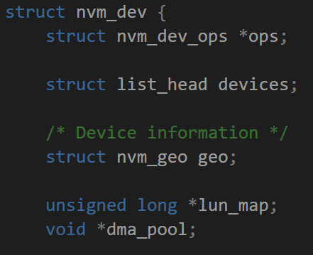
struct nvm_dev
device geometry & target division
code: include/linux/lightnvm.h
Notes:
每块物理OCSSD设备通过NVMe Driver激活LightNVM后，Media Manager会为其创建nvm_dev结构体实例，代表一块完整的设备；
nvm_dev可以被划分为多个target，但LightNVM只能按照PU为基本单位进行划分，这也是因为PU物理上隔离，能够保证IO隔离性。

Slide 24
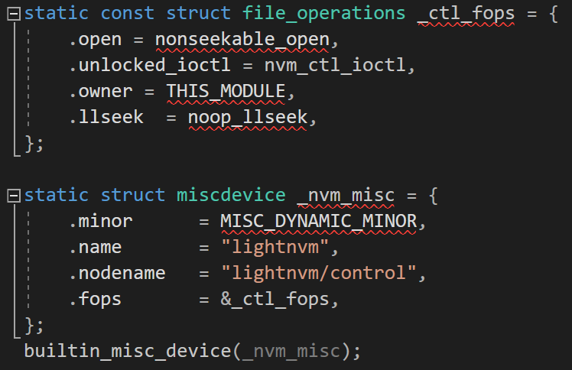
Create Target (pblk)
build a miscdevice for a device which supports LightNVM
code: drivers/lightnvm/core.c

Slide 25
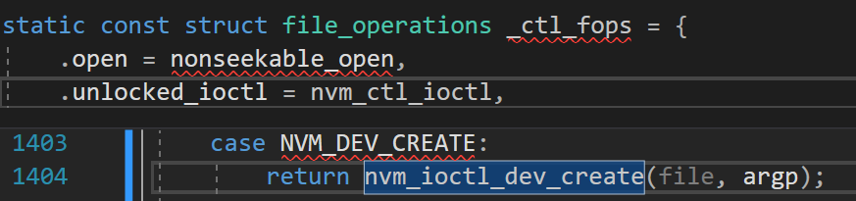
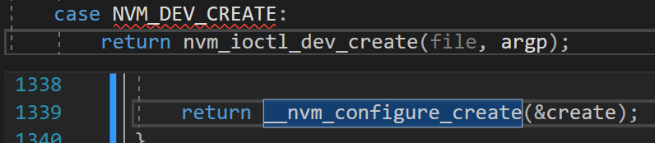
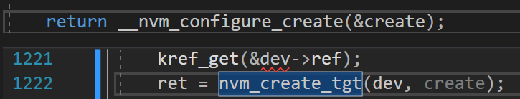
Create Target (pblk)
Create target (pblk) in the process of building a miscdevice
code: drivers/lightnvm/core.c
Notes:
在这个函数中每个target对应到一个nvm_tgt_dev的结构体，以及用于处理这个target的负责实现FTL功能的target type，pblk。

Slide 26
3.3
IO stack

Slide 27
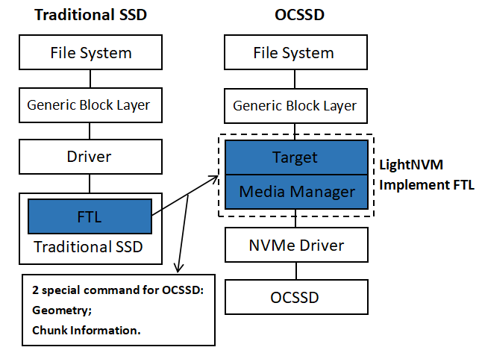
New IO Stack with LightNVM
block layer - LightNVM: make request function to deal with bio from file system directly
LightNVM - driver: request function to submit the request to the NVMe device driver

Slide 28
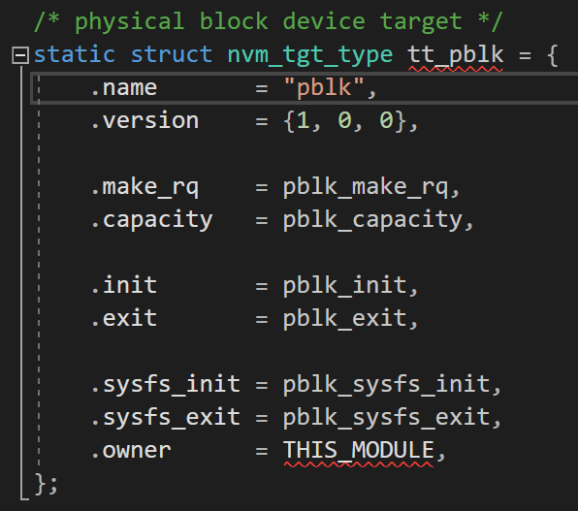
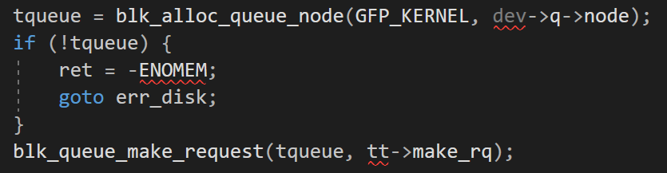
New IO Stack with LightNVM
pblk entry functions
code: drivers/lightnvm/pblk-init.c
insert pblk_make_rq() function into target's request queue in the process of creating target
code: drivers/lightnvm/core.c

Slide 29
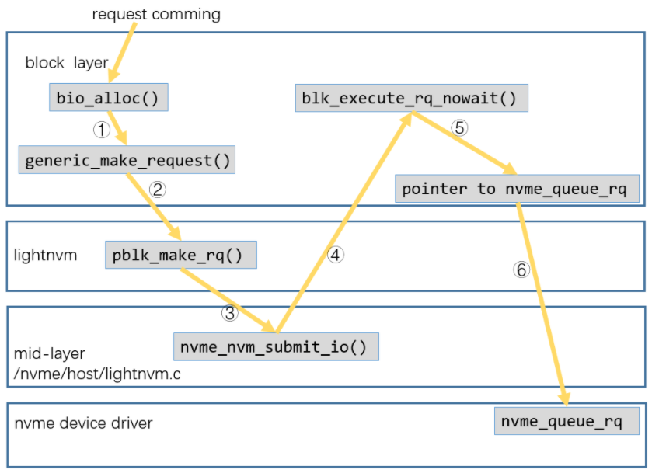
New IO Stack with LightNVM
register make request function to request queue
register request function to request queue

Slide 30
3.4
pblk
FTL - Read/Write/GC

Slide 31
pblk - Read
code: drivers/lightnvm/pblk-read.c
1. look for L2P table to get physical address;
2. look for write buffer, if hit, read data from buffer;
3. if not hit, construct bio to read data from device;
4. if partially hit, construct bio for miss hit part to read them from device. Then, combine this part data with the hit part data read from buffer.

Slide 32
pblk - Write
code: drivers/lightnvm/pblk-write.c
1. write data to write buffer:
1.1 judge whether there are enough space in write buffer;
1.2 if not, trigger write thread to write back;
1.3 write data to buffer and update L2P table;
2. judge whrther need to trigger write thread to write data from buffer to device (timer trigger/the number of entries needed to be write back is reach the threshold);
3. if trigger write thread, write data from buffer to device:
3.1 caculate the number of entries (buffer unit) needed to be write back;
3.2 construct bio with these entries;
3.3 set up write request.

Slide 33
pblk - GC
code: drivers/lightnvm/pblk-gc.c
triggering conditions: timer trigger/write thread trigger gc actively
GC unit: line (chunks with the same offset)
gc full list: only full lines can be added into gc full list
GC stop condition: the number of free chunks reach the threshold
1. if trigger gc, read vaild data from line and write data to write buffer;
2. the erase operation is executed with write thread.

